Slide 1

A Presentation
on
Mini project 3
“ Car Recommendation System”
Presented by
AMAN RAJ (MITU19BTCS0002)
CHINMAY MANDAVKAR (MITU19BTCS0169)
GAURAV KUMAR (MITI20BTCS0014)
AMAN BHARTI (MITU19BTCS0001)
Guided By
Prof. SHAHIN MAKUBHAI
DEPARTMENT OF COMPUTER SCIENCE AND ENGINEERING
MIT SCHOOL OF ENGINEERING
LONI, PUNE

Slide 2

INTRODUCTION
Choosing the most appropriate vehicle is a challenging task for the customers who are planning to buy a vehicle. It requires technical expertise to some extent and guidance to make the right choice by analyzing the customer’s requirements.
Thus, most of the vehicle buyers seek services from experts or consultants before buying a vehicle. Therefore, we are investigating a potential solution for this issue using modern machine learning technologies.

Slide 3
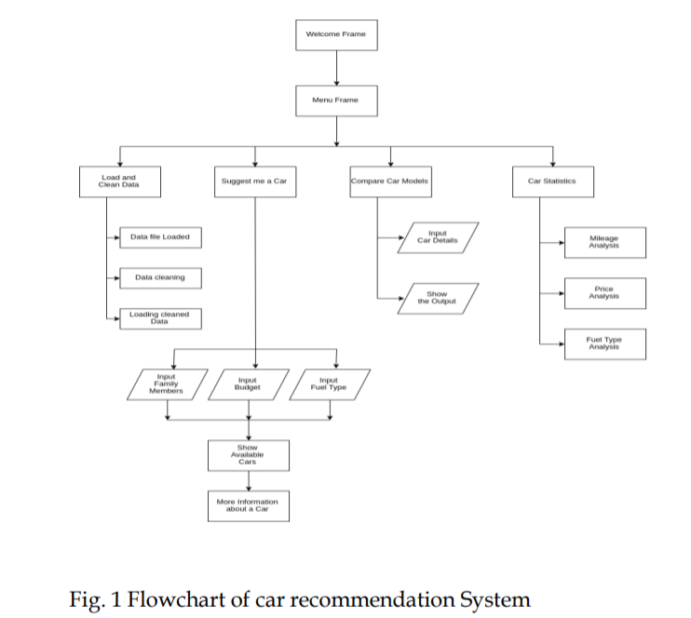
DESIGN

Slide 4
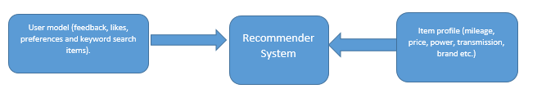
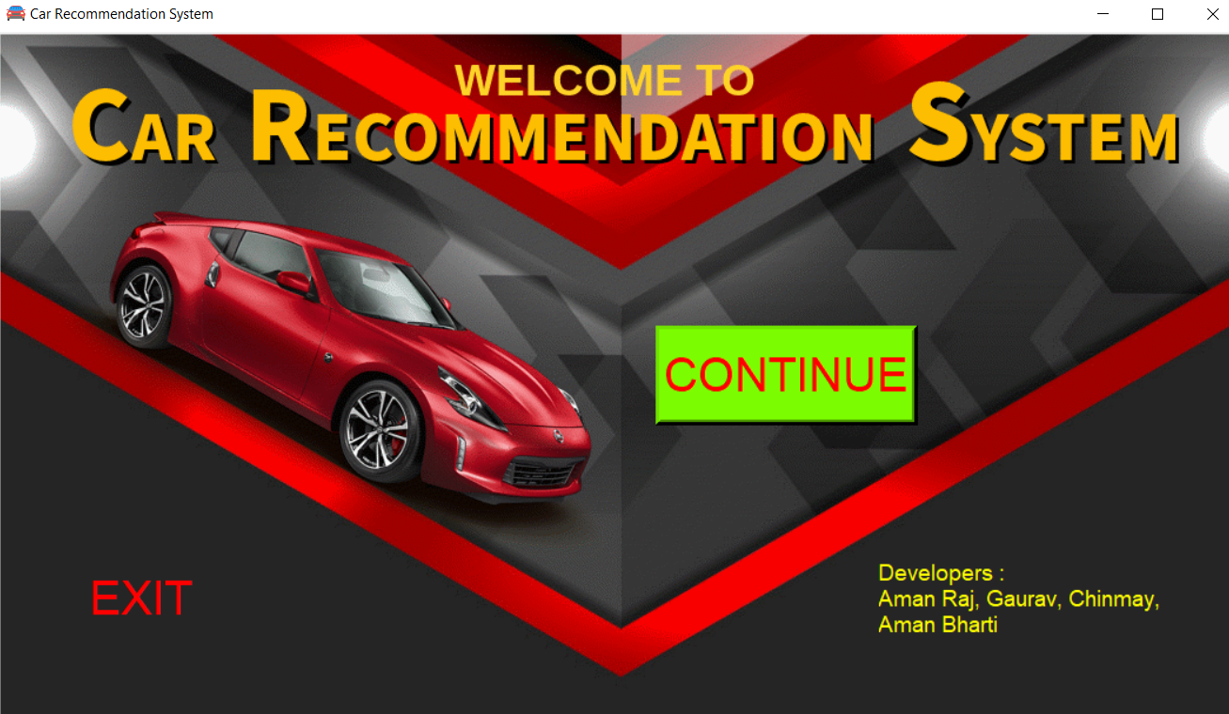
PROJECT IMPLIMENTATION
first module is home page, which consists of login screen for authenticate persons to entry and over view about the system

Slide 5
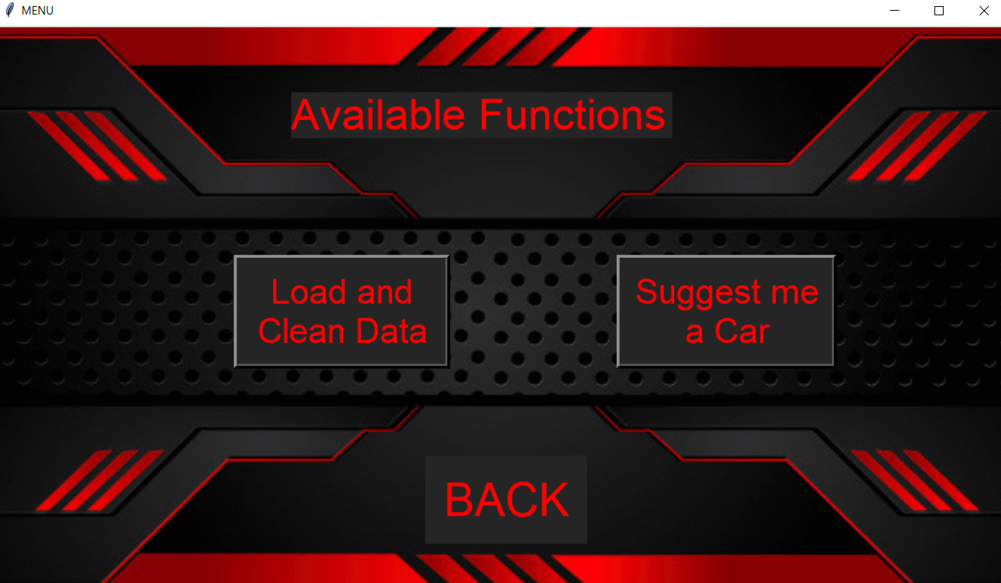
The second phase of projects consist of various available functions such as load and clean data, suggest me a car, Compare Car models and different statistics about various car modules. Each and every module has specific functions and operations

Slide 6
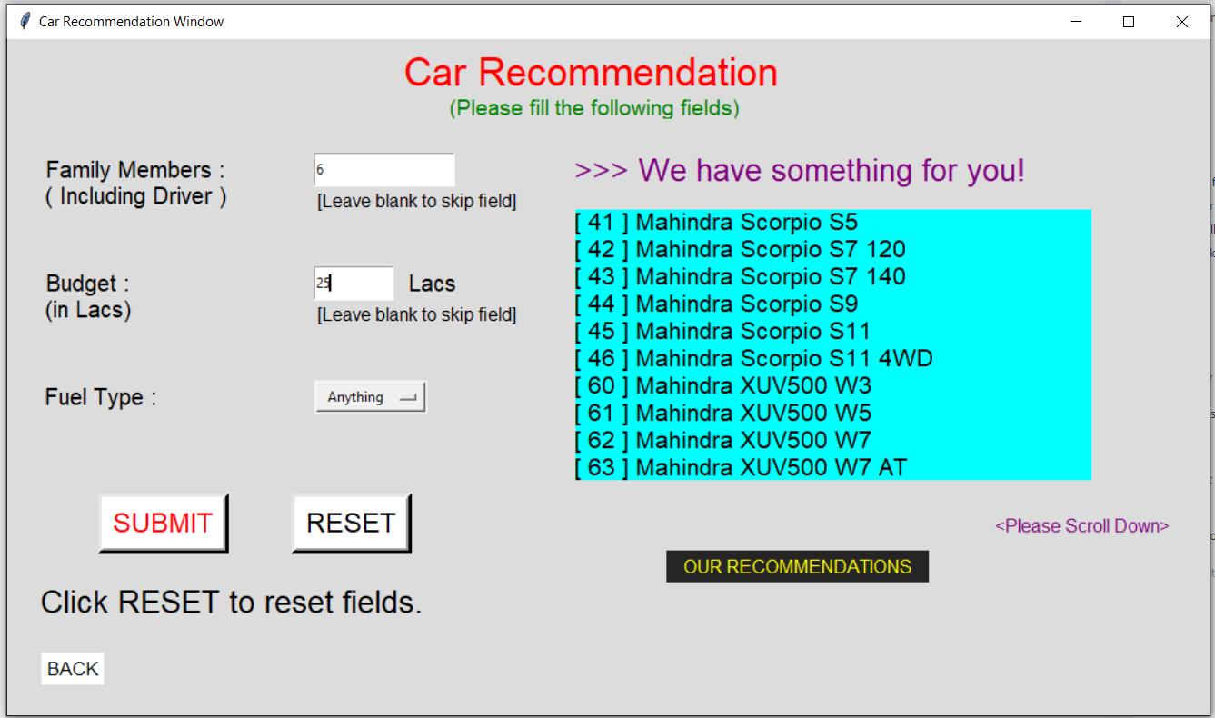
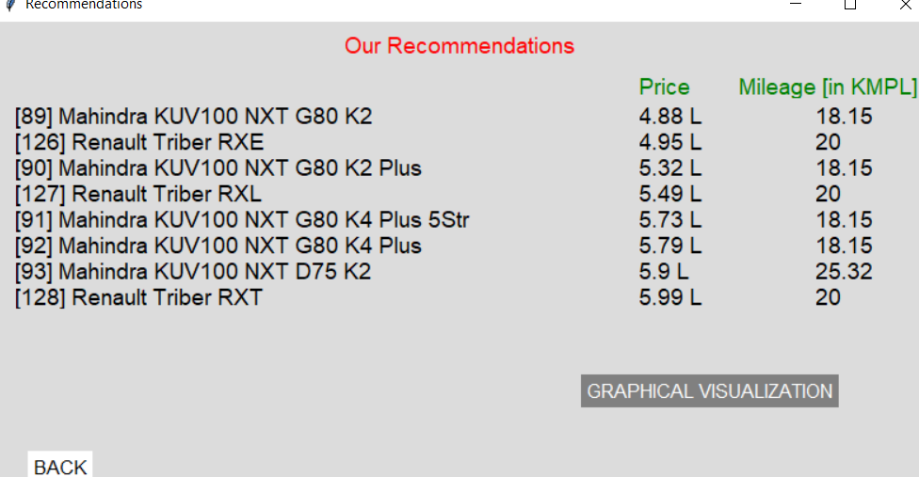
Clicking on “Suggest me a Car” in the MENU FRAME brings you on this frame.
In this window, you can input your data to get suggetions.

Slide 7
.. This system is mainly help clients to purchase car without more knowledge about car, also suggests various options available based on the customer requirements. .. This system has the potential to reduce a lot of research work of the user. It can correctly suggest the user car model(s) based on his/her requirements. To provide accurate and up-to-date information to the user, links are provided for each car model. .. The user can click on the link and thereby get the latest, updated information on the internet. This is very useful as the user can view the images, 360 degrees view of the car, reviews of other users, ratings, etc. .. Data Visualization helps to see the analysis of the available car models at a glance. If user is low on budget, he/she has an option to view Car Loans of popular banks and direct links to get the same. This system can surely help to choose the appropriate car meeting the user’s requirements.

Slide 8
THANK YOU

